Slide 1
Animals: Arthropods and Echinoderms
This PowerPoint presentation was developed to coincide with an eighth grade science textbook.
This PowerPoint presentation is used to introduce and teach vocabulary words. It is also used to teach and review important concepts. Students take notes during the presentation. The slides are printed leaving the lines blank. The students are able to keep and use these notes throughout the unit.
Objectives:
Students will identify animals classified as arthropods and echinoderms.
Students will be able to explain the characteristics of arthropods and echinoderms.
Students will identify the differences between arthropods and echinoderms.

Slide 2
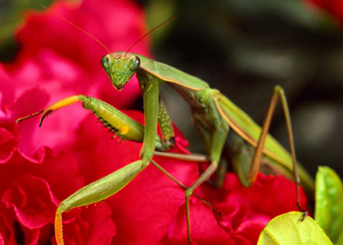
Arthropods and Echinoderms

Slide 3
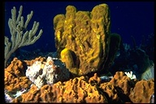
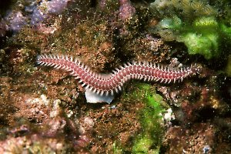
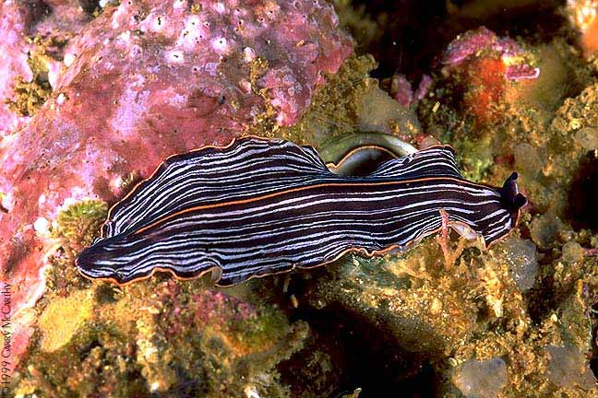
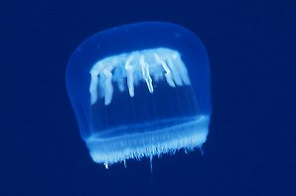
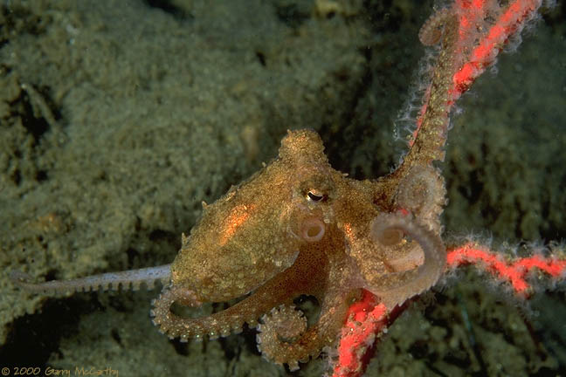
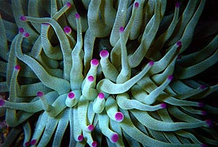
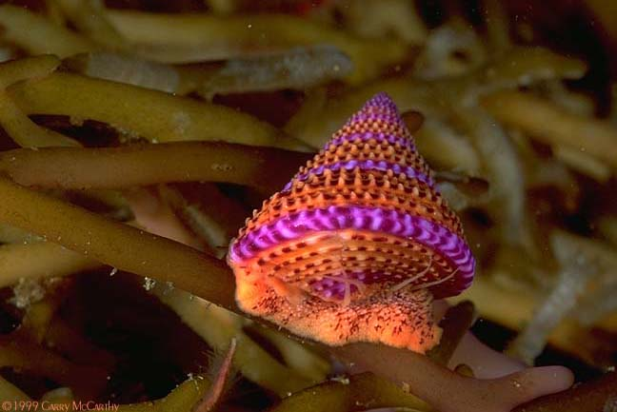
Invertebrates
Invertebrates are animals that have no backbone.
There are ____ kinds of invertebrates.
six
You have already learned about two kinds.
Sponges
Annelids
Cnidarians
Mollusks

Slide 4
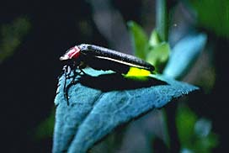
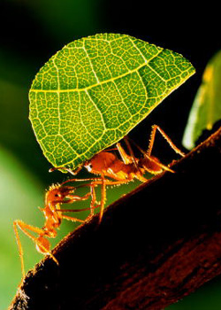
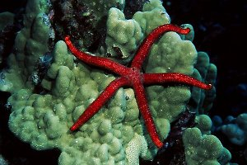
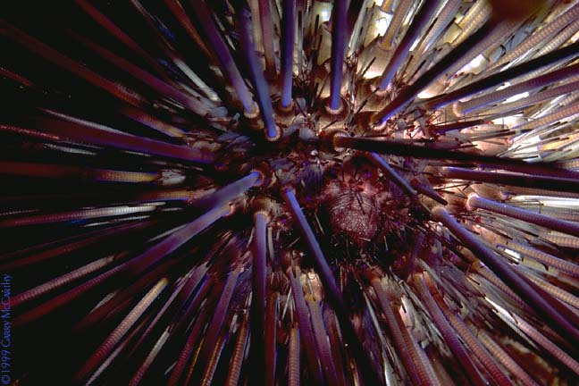
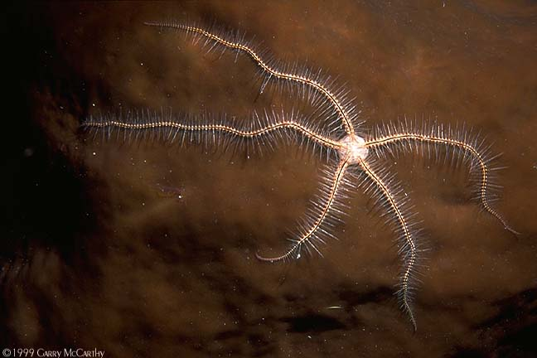
Now, let's learn two more!
1. Sponges
5. Arthropods
2. Cnidarians
3. Worms
4. Mollusks
6. Echinoderms

Slide 5
Arthropods
An arthropod is an invertebrate with an exoskeleton, a segmented body, and jointed legs.
There are four main kinds of arthropods.
1. Crustaceans
3. Centipedes &
Millipedes (Myriapods)
2. Spiders & Scorpions
Ticks & Mites (Arachnids)
4. Insects

Slide 6
Arthropods
There are more than 1 million kinds of arthropods on Earth.
There are three characteristics that all arthropods have.
1. exoskeleton
2. segmented body
3. jointed legs

Slide 7
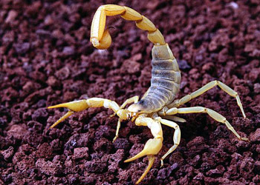
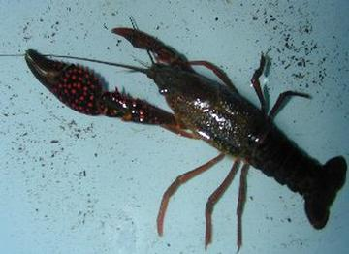
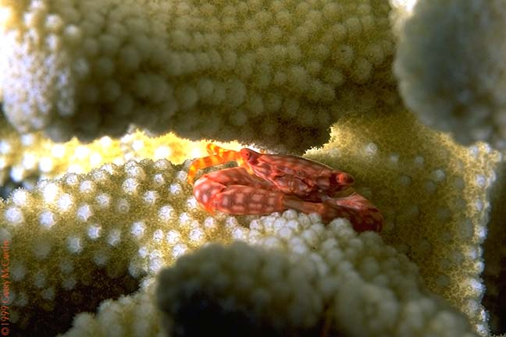
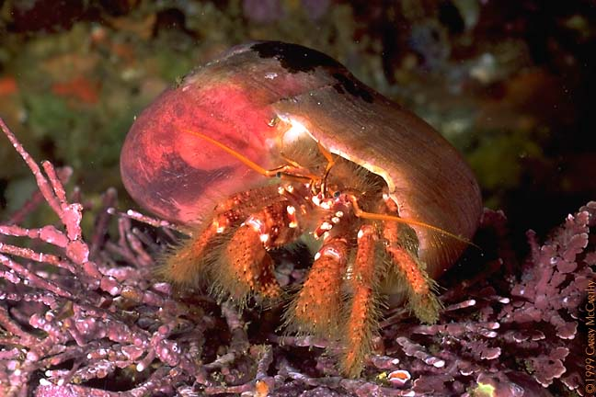
All arthropods have an
exoskeleton.
An exoskeleton is a hard, outer covering.

Slide 8
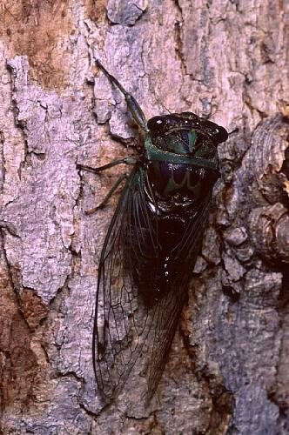
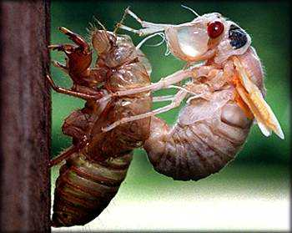
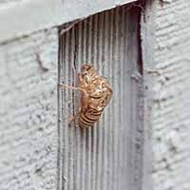
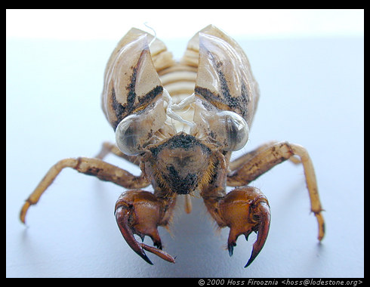
Some arthropods grow too big for their exoskeletons.
molt.
These arthropods will
Molting is to leave an exoskeleton and grow a new one.

Slide 9
More Characteristics of Arthropods
Arthropods have segmented bodies.
Arthropods have jointed legs.
Arthropods have a heart to
pump blood through their bodies.
Arthropods reproduce sexually.

Slide 10
Four Kinds of Arthropods
Arthropod
Crustacean
Insects
Myriapods
Arachnids
crab
grasshopper
lobster
butterfly
barnacle
beetle
spider
centipede
shrimp
bee
scorpion
millipede
moth
tick
ant
mite

Slide 11
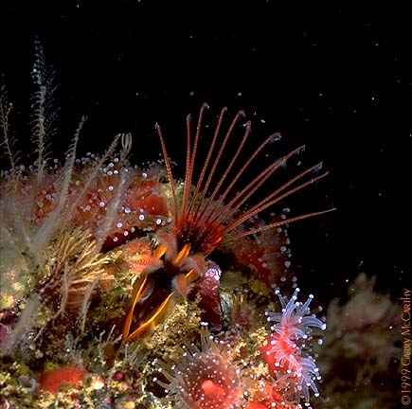
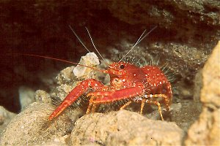
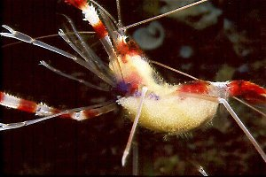
Crustacean
A crustacean is an arthropod that has a hard, exoskeleton, two pairs of antennae, and a mouth for crunching and grinding.
Crustaceans are ...
Crabs
Lobsters
Barnacles
Shrimp

Slide 12
Crustaceans
Crustaceans can ________ certain parts of their body.
re-grow
stone crab
A ___________ can re-grow its claws.
Most crustaceans live in ______ and get oxygen from the water through _________.
water
gills
Gills are
special respiratory organs that help some
animals breathe and get oxygen from the water.

Slide 13
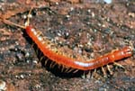
Centipedes and Millipedes
* Centipedes and millipedes are arthropods that have many legs.
Centipedes
* Have _______ pair of legs in each segment.
one
* Are carnivores and eat _________.
other animals
* To capture its prey, a centipede puts _______ into the prey’s body with
poison
claws
Centipedes are found in _ _________ like under rocks and in the soil.
wet places

Slide 14
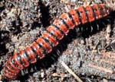
Centipedes and Millipedes
* Centipedes and millipedes are arthropods that have many legs.
Millipedes
two
* Have ___ pairs of legs on each segment.
* Eat _________ and are shy animals.
plants
rolls up into a tiny ball
* When scared, it _________________ to protect itself.
claws
* Do not have ________.
* Are found in __________like under rocks and in the soil.
wet places

Slide 15
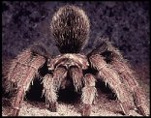
Arachnids: Spiders, Scorpions
Ticks, and Mites
eight
* All have __________ legs.
* Have a body divided into two parts:
__________________________ ____
__________________ ____________
a head and chest part (cephalothorax)
an abdomen (stomach)

Slide 16
Cephalothorax- head/chest
(head) (chest)
Abdomen- stomach

Slide 17
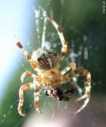
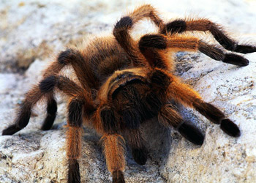
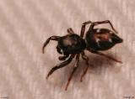
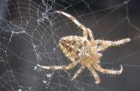
Spiders (Arachnids)
* Spiders usually eat __________, but some spiders eat small _______________ like hummingbirds.
bugs
vertebrates
silk
* Many spiders make webs out of _________.
* Silk is _________________________________.
a thin, strong thread made in the stomachs of spiders

Slide 18
Spiders (Arachnids)
* Spiders catch their prey in many different ways.
webs
* Some spiders catch their prey in ____.
hide
* Some spiders ________ from their prey and then ________________________.
jump out and catch the prey
* When spiders catch their prey, it _______ it and _________ it.
bites
poisons
* Spiders breathe oxygen with __________.
lungs

Slide 19
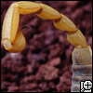
Scorpions (Arachnids)
* Scorpions usually live in __________ areas.
dry desert
nocturnal
* Most scorpions are __________________.
** Nocturnal means ____________________
to be active during the night
* During the day, scorpions hide __________ ______________________________.
under logs
and rocks, or in holes in the ground
* When scorpions capture prey, they _______ ___________________________________.
hold it
with their large claws and sting it with their tails

Slide 20
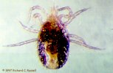
Ticks and Mites Are Harmful
* Many ticks suck the blood from _________.
larger animals
* Ticks can give animals a ____________.
disease

Slide 21
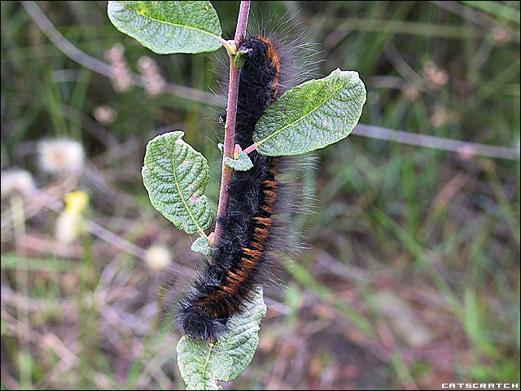
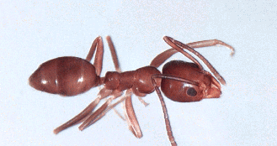
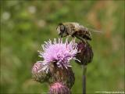
Insects
*There are more kinds of insects than there are all other animal species all together.
* There could be _______________ times as many insects as humans on Earth.
300 million
* Insects have a body that is divided into ____ parts.
three
* An insect’s body is divided into a ________, a ___________, and a _____________ area.
head
thorax
abdomen

Slide 22
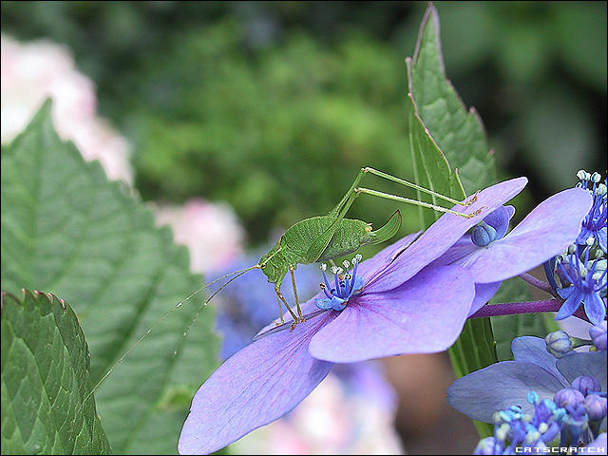
Insect Structure
* Insects have _____ legs connected to the chest part.
six
* Some insects’ legs are all the same size. Some insects have one pair of legs larger than the other two pairs.
* A grasshopper has one pair of legs larger than the other two pairs. These larger legs are used for ____________.
jumping
Longer back legs

Slide 23
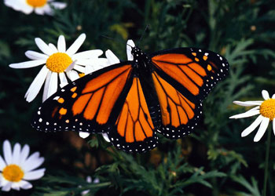
Insect Growth and Development
* Insects eat a lot, so they grow very fast. As they grow, insects may molt and grow new ___________, or they may change completely.
exoskeletons
metamorphosis
* A huge change in appearance is called ________.
* There are two kinds of metamorphosis:
______________ and ______________.
complete
incomplete

Slide 24
Complete Metamorphosis
* In complete metamorphosis, insects like butterflies and moths have _______ stages of development.
four
* The first stage makes an ________.
egg
* During the second stage, the egg hatches and a _________ comes out.
larva
* A caterpillar is the larva of an insect that will become a butterfly or a moth.

Slide 25
Complete Metamorphosis
* During the third stage, a ___________ is made.
pupa
* A pupa is sometimes wrapped in a _____________ or in a _______________.
cocoon
chrysalis
* A cocoon is the pupa of a _____________. A cocoon is made of ________.
moth
silk
* A chrysalis is the pupa of a ___________.
butterfly
* In the last stage, the insect is finally an adult.

Slide 26
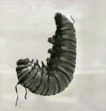
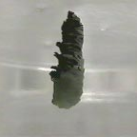
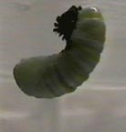
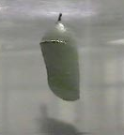
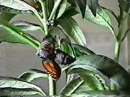
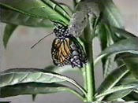
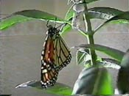
From Caterpillar to Butterfly
Larva
Pupa
Chrysalis
Emerging butterfly
Monarch butterfly

Slide 27
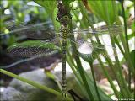
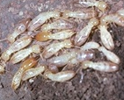
Incomplete Metamorphosis
* Incomplete metamorphosis happens in grasshoppers, termites, and dragonflies.
* In incomplete metamorphosis, young animals that look like the ___________ hatch from eggs.
adult
* As the young animals grow, they keep _________, shedding their exoskeletons, and getting larger.
molting

Slide 28
Metamorphosis Comparison
Complete
Incomplete
* Occurs in four stages
* Young insect looks
like the adult
egg
larva
pupa
adult
* Insect grows bigger
and bigger
* Insect's appearance
changes completely
* As the insect grows,
it sheds its exoskeleton
* Young insect looks
nothing like the adult
* Occurs in butterflies
and moths

Slide 29
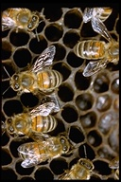
Insect Behavior
* Most insects live alone. But, some insects are ___________ and cannot survive alone.
social
* These insects live in ______________ or hives.
colonies
* A colony is _____________________________ _______________________________________
a group of insects living together.
The insects do different jobs and are very organized.

Slide 30
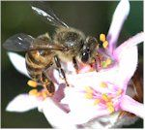
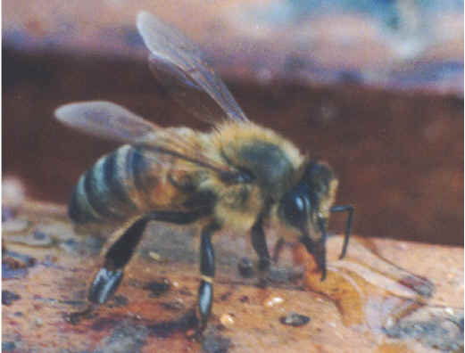
Insect Behavior
* An amazing example of a colony is a __________.
beehive
* A beehive is ___________________________.
a very organized colony of bees

Slide 31
Insects' Defense
* All insects must protect themselves.
* Bees and wasps have _______________ to protect themselves.
stingers
* Many other insects use ______________.
camouflage
* Camouflage allows an insect to hide by ___ _______________________________.
blending in with their environment

Slide 32
Echinoderms
* Echinoderms are __________, ________, __________, ________, ____________, and _____________.
starfish
sea lilies
feather stars
sea urchins
sea cucumbers
sand dollars
* Echinoderm means _______________. All echinoderms have spiny skin.
spiny skin

Slide 33
Echinoderms
There are ______ characteristics of echinoderms.
five
All echinoderms have:
Spiny skin
An internal skeleton
A five part body
A water vascular system
Tube feet

Slide 34
Characteristics of Echinoderms
* All echinoderms have __________. Some of them have small hair-like spines, like the starfish.
spiny skin
* Some echinoderms have long spines, like the sea urchin.

Slide 35
Characteristics of Echinoderms
* The internal skeleton of an echinoderm is made of _______________________.
bony plates that are bumpy or spiny.
* An echinoderm’s water vascular system is _________________________________.
a system of tubes that carry food and oxygen and remove wastes
* The water vascular system also helps an echinoderm _____.
move

Slide 36
Characteristics of Echinoderms
tube feet
* Echinoderms have __________.
tube feet
* An echinoderm’s tube feet are used for _________________________________.
moving and for getting food

Slide 37
Seastars
* Seastars are also called ___________.
Starfish
* Seastars have __________ arms connected to a central body.
five or more
* On the bottom of the arms are hundreds of ___________ that look like suction cups.
tube feet

Slide 38
Seastar
* A seastar is able to re-grow its arms.
* A seastar uses its tube feet to move and to open its food.

Slide 39
Sea Urchins
* Sea urchins have longer and sharper ________ that they use to protect themselves.
spines
* Some sea urchins have ________ spines.
poisonous

Slide 40
Sea Urchins
* Sea urchins have a mouth hidden under its body.
* A sea urchin uses its five teeth to eat ____________.
sea plants
* A sea urchin is not very active. Sometimes, it does move slowly using its __________. When not moving it uses its feet to stick to the ocean floor.
tube feet

Slide 41
Sea cucumbers
____ __________
Sand dollars
Sea lily

Slide 42
A Review
Arthropods
Echinoderms
Crustaceans
Starfish
Spiders & Scorpions
Ticks & Mites
Sea Urchins
Sand dollars
Centipedes &
Millipedes
Sea lilies
Insects
Sea cucumbers

